Slide 1

Artik

Slide 2

What is Artik?
Library for cache side channel attacks
Architectural Real Time Intelligent Attack (?)
Notes:
Artik is a library we built

Slide 3
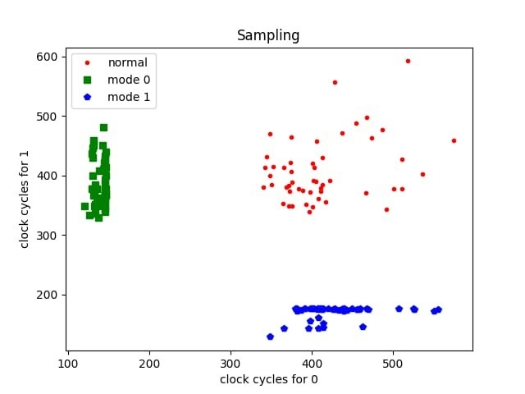
Does it work?
Hopefully.
Just look at the graph
Notes:
Artik is a library we built

Slide 4
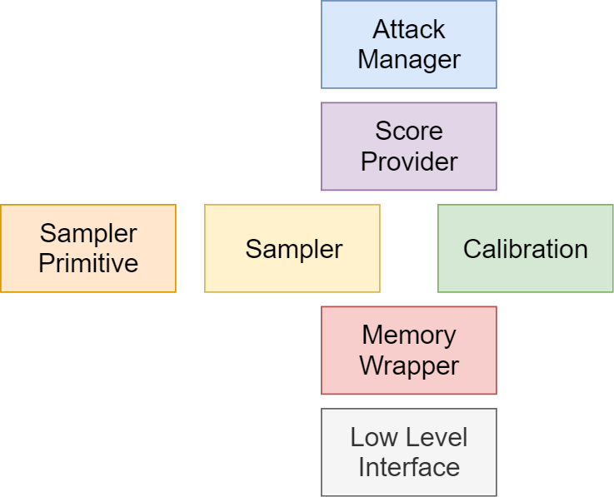
Structure
Attack Manager
Sampling
Calibration
Memory Wrapper
Low Level

Slide 5
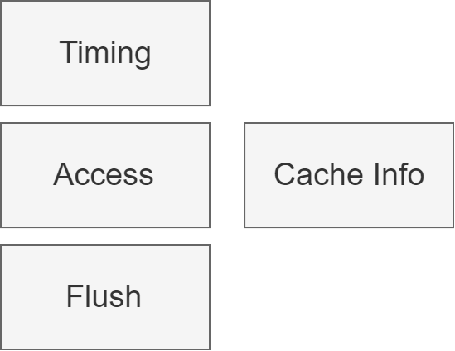
Low Level Interface
In charge for abstracting machine specific code
Wrapper for assembly function

Slide 6
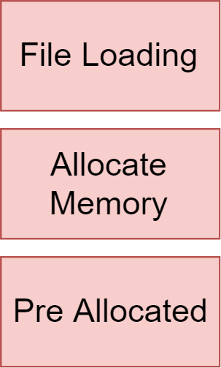
Memory Wrapper
Abstraction for memory
Generic, works for Flush+Reload and PrimeProbe
Allow flushing, accessing, loading and more

Slide 7
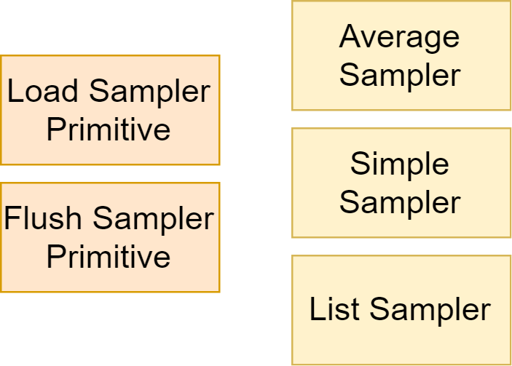
Sampler
Performs all the logic of sampling in each pattern
Uses Sampler Primitive and Memory Wrapper
Returns a list of measurements

Slide 8
Calibration and Score Provider
Calibration takes measurements and analyze the results
Calibration outputs a score provider
Score provider - a generic way to measure how likely a measurement to be influenced by the victim

Slide 9
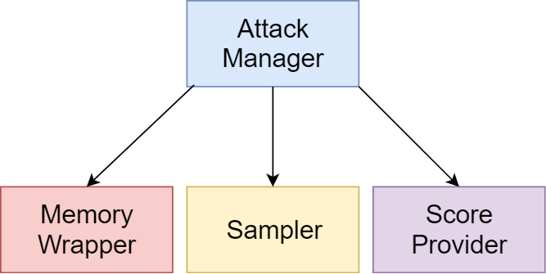
Attack Manager
Coordinate the attack
Perform calibration
Call sampler
Use score provider to determine where victim touch
Out a attack results

Slide 10
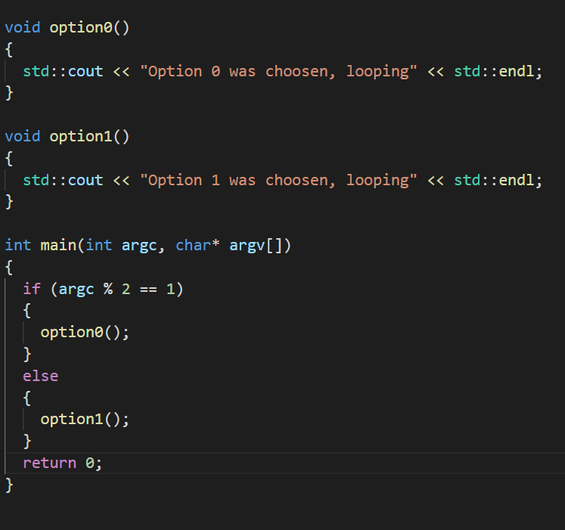
A Simple Example
We need to figure out which option the victim chose.
For that we use the Flush+Reload in Artik.

Slide 11
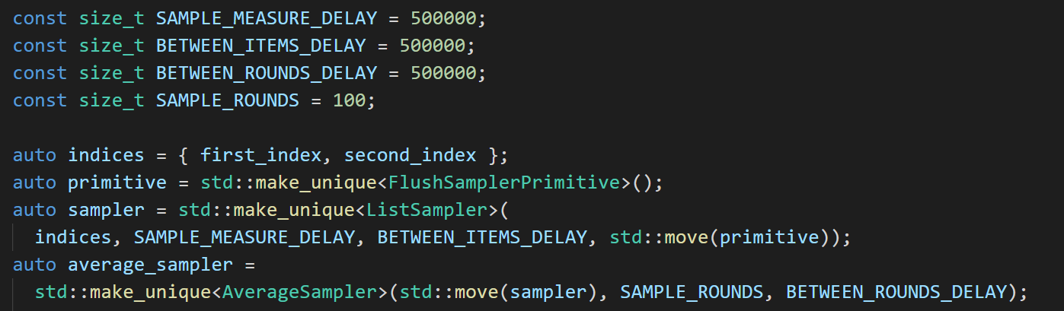
Setup the Sampler

Slide 12

Attack Manager and Memory Wrapper

Slide 13
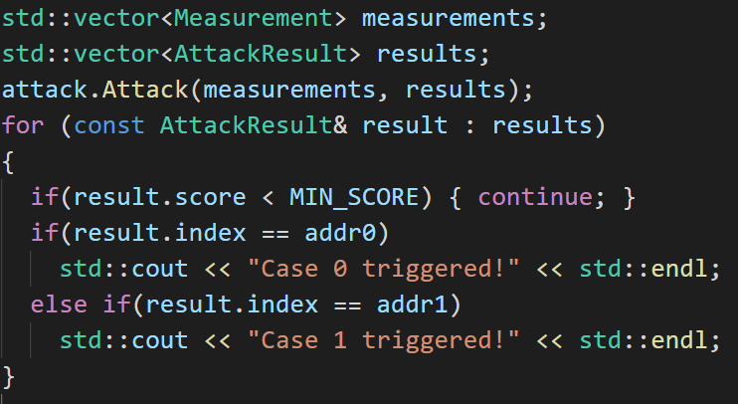
Attacking

Slide 14
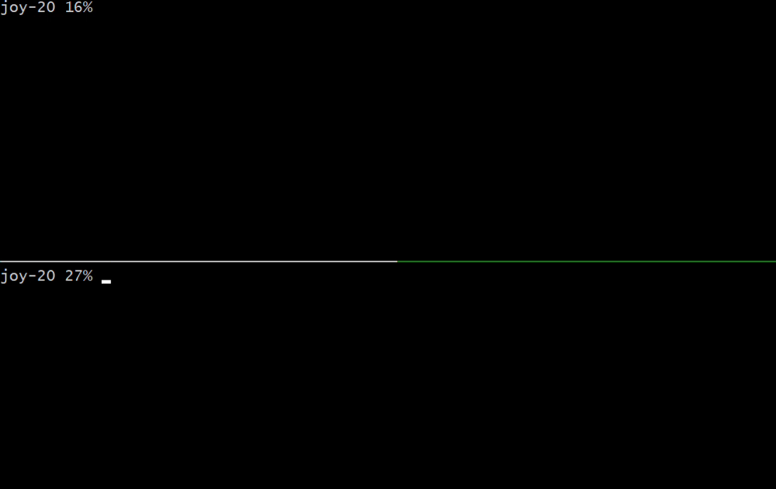

Slide 15

Dragon Blood
Cache side channel attack on WPA3
This Photo by Unknown Author is licensed under CC BY-NC-ND

Slide 16
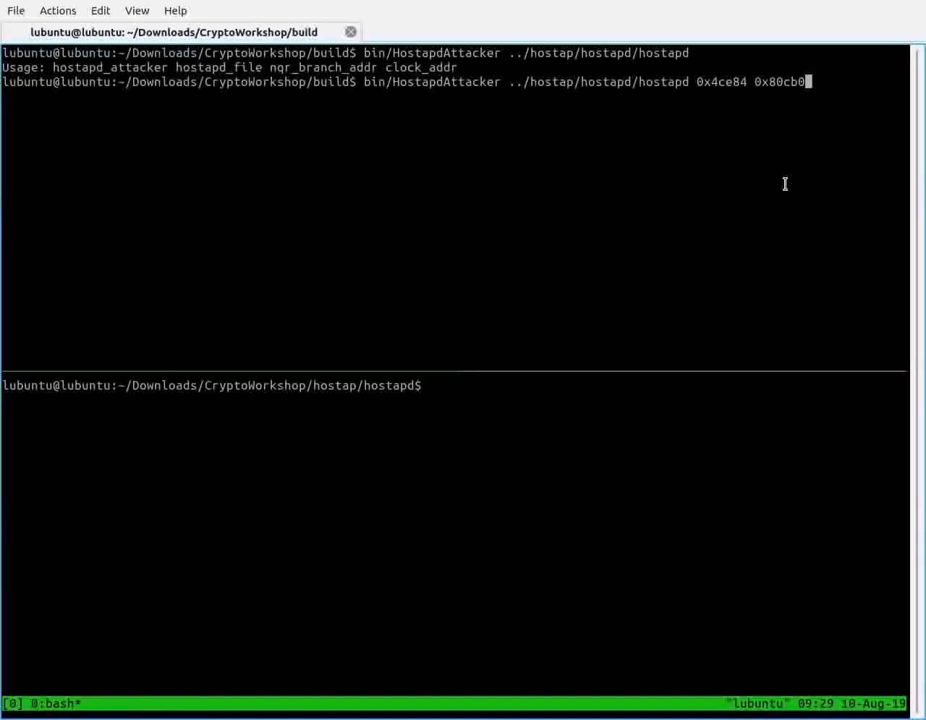

Slide 17
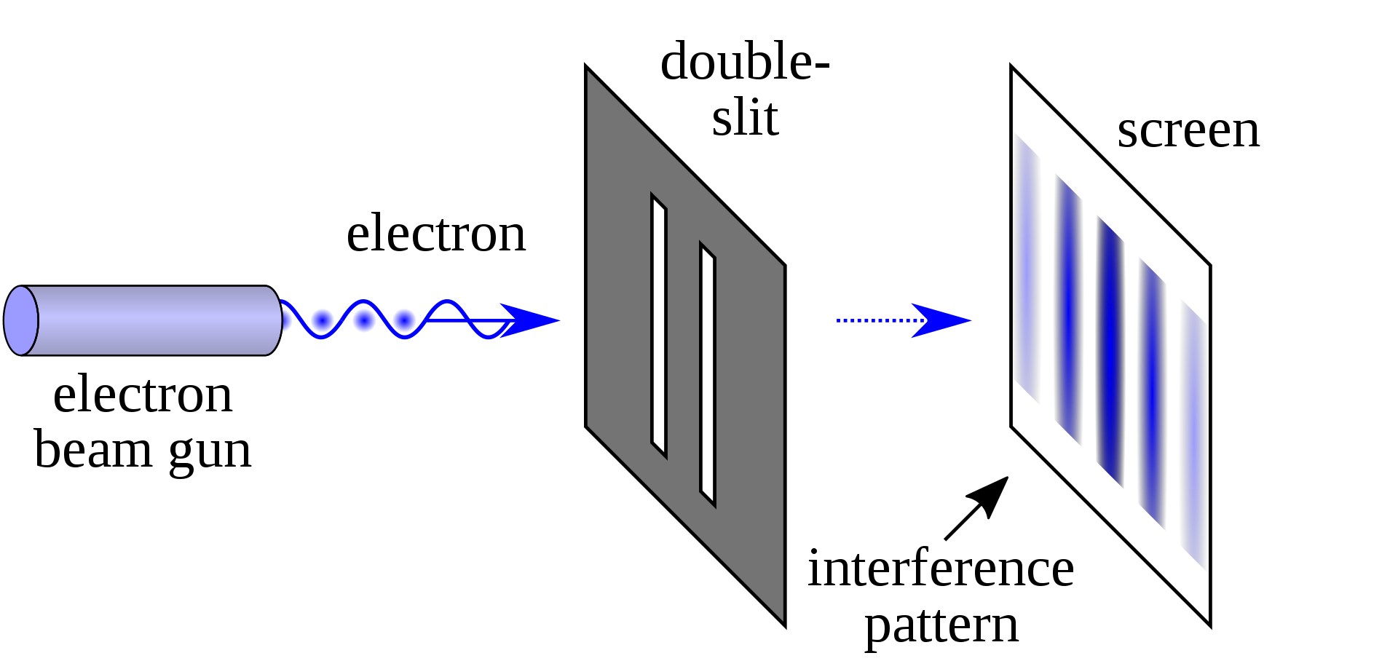
Challenges
Cache is hard

Slide 18
Challenges
Measuring cache can change the results
Careful memory management
Move often, copy only when you must
Generic support for Flush+Reload, PrimeProbe and possibly other
Setting up wpa3 hostpad for Dragonblood attack

